Slide 1

BioIndex tool
2nd Training
Excelsior Hotel, Bari (Italy), 20th-24th January 2025
W. Zupa, I. Bitetto

Slide 2


Introduction to BioIndex
BioIndex is an R package designed for analysing fisheries survey data, particularly from the MEDITS program and similar projects. It supports ecological management through robust data processing and indicator computation.
BioIndex enables users in conducting comprehensive data analyses with the estimation of a wide range of population indicators, providing insights for fisheries management policies.
Designed for fisheries and environmental management: BioIndex is integrated within RDBFIS to streamline workflows for sustainable fisheries governance.
Environment
R > 4.2.2
Rstudio

Slide 3

Key Features of BioIndex
Perform the analysis on survey data following the random stratified sampling at GSA/country level.
Perform trend analyses, spatial analysis, and demographic analysis.
Operate either independently or as part of the RDBFIS environment.
Open-source software.
GitHub repository: https://github.com/COISPA/BioIndex.
Detailed documentation included in the R package and in the GitHub repository.
Data Requirements and Input Formats
Supported input formats: processes CSV files derived from MEDITS surveys (TA, TB, TC tables). TE and TL data are supported for standalone analyses (RDBFIS).
Input structure compliance: Requires strict adherence to data format and structure.
Data validation with RoME: All datasets must previously pass integrity checks with the RoME package to ensure readiness for analysis.

Slide 4
Workflow and Data Validation in RDBFIS
RoME integration ensures data integrity before data upload in the DB and further processing. Integrity checks are included in the tool to identify and report missing or inconsistent data, generating detailed logs of consistency checks.
BioIndex in RDBFIS analyses data in TA, TB and TC format already resident in the DB, already checked and validated for compatibility.
Streamlined workflows: Simplifies analyses within the RDBFIS environment.
Outputs are produced and pooled in a unique zip file to be downloaded by the user.

Slide 5
Statistical and Analytical Capabilities
Estimation of different indices: abundance, biomass, MIW, sex ratio at different aggregation level (GSA/country, strata, sex).
Demographic evaluations: explores size distributions and life stage dynamics through statistical summaries at different aggregation level (strata, sex).
Trend analysis: Detects changes over time using the Spearman test.
Spatial analysis: Analyses distribution patterns with GFCM grids and bubble plot maps of abundance.

Slide 6
Biological Indicators
Abundance indices (number/km²): Abundance indices can change for the effect of an excessive fishing pressure, and are likely to be substantially affected by large recruitment pulses in the stock, particularly if numbers of adults are low.
Biomass indices (kg/km²): This index measures the total biomass of a species per unit area. Changes (e.g. decrease) in these indices can be caused by an excessive fishing pressure.
Mean individual weight (MIW): Reflects changes in species' average body size. MIW is generally considered an indicator that synthesizes the structure of the population (Piet and Jennings, 2005) and its changes in time are likely linked to changes in fishing pressure, though it can be also influenced by the recruitment peaks.
Length-based indicators (L50-L95): The different percentiles of a length frequency distribution (LFD) are expected to respond differently to fishing, recruitment pulses, and loss of spawning stock. A large percentile of the population length distribution (L95) is an indices of the numbers of adult, older fish. It is assumed to be negatively affected by an excessive fishing pressure.
Life stage-specific indices (number/km²): represent juveniles identified by length or age, and spawners, adults exceeding the size at first maturity. They provide essential insights into recruitment success and reproductive potential, critical for population sustainability.
Sex ratio: and indicates the level of sex dominance and provides insights into reproductive potential, being correlated with the stock productivity and renewal.
Inverse of Coefficient of variation: could be interpreted as a descriptor of the stability of the index under investigation (higher is the metrics, more stable is the variable).

Slide 7
Core analyses and functions
Main function: BioIndex
Function | description
merge_TATBTC | Generate the tables merging TA-TB and TA-TC tables
hauls_position | Plots the hauls position on a map
bubble_plot_by_haul_indexes | Produces bubble plots of the abundance indices by haul
bubbleplot_RS_by_hauls | Produces bubble plots of the abundance indices by haul of recruits and spawners
indices_ts | Estimates the time series average values for the following indices: mean abundance index (number/km²) mean abundance index (number/km²) by depth stratum number of hauls positive to the species inverse of mean abundance Coefficient of Variation (1/CV) mean biomass index (kg/km²) mean biomass index (kg/km²) by depth stratum
indices_ts_F indices_ts_M | Time series of mean abundance index (number/km²) of females and males
index_recr index_spawn | Time series of mean abundance index (number/km²) of recruits and spawners
sex_ratio | Time series of sex ratio
Function | description
MIW | Estimates the time series average values for: mean individual weight (MIW) mean individual weight (MIW) by depth stratum
Spearman | detect changes over time using the Spearman test (trend analysis)
IUT | Intersection Union Test (trend analysis)
overlayGrid index_on_grid plot_GFCM sex_ratio_on_grid | Prepare the merging tables (TA-TB and TA-TC) for the spatial analyses, and produce maps of the spatial distribution on the GFCM grid of the following indices: abundance index (number/km²) inverse of mean abundance Coefficient of Variation (1/CV) biomass index (kg/km²) mean individual weight (MIW) sex ratio
LFD Lquant | Estimate the length frequency distributions (LFD) by sex and depth stratum, and the length at 95° and 99° percentile (L0.95, L99)
ALK LW | Estimation of Age-Length Key relationship (TE table) Estimation of Length-Weight relationship (TE table)

Slide 8
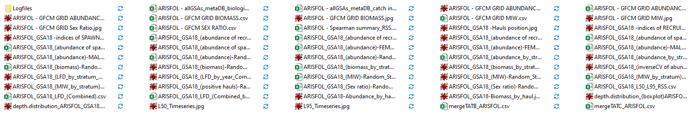
Outputs
CSV table: Outputs suitable for further analysis or direct reporting.
Graphical outputs: Includes boxplots, bubble plots, heatmaps, and spatial grids for enhanced insights.
All the outputs are downloaded in a unique zip file (RDBFIS) or saved in a user-selected local folder (stand alone use). Zip files safeguards results with session-specific archives, preventing accidental overwrites or data loss.

Slide 9
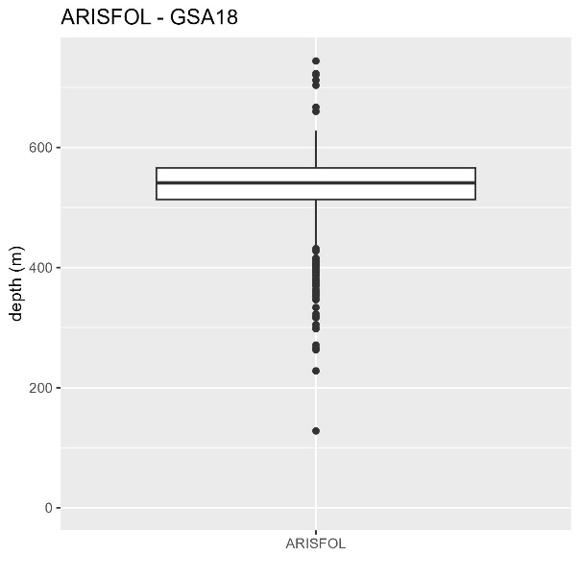
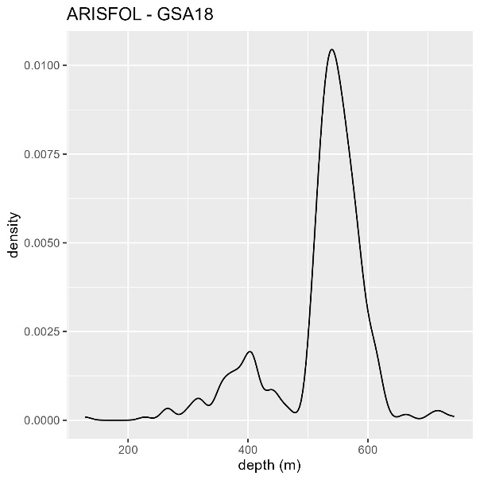
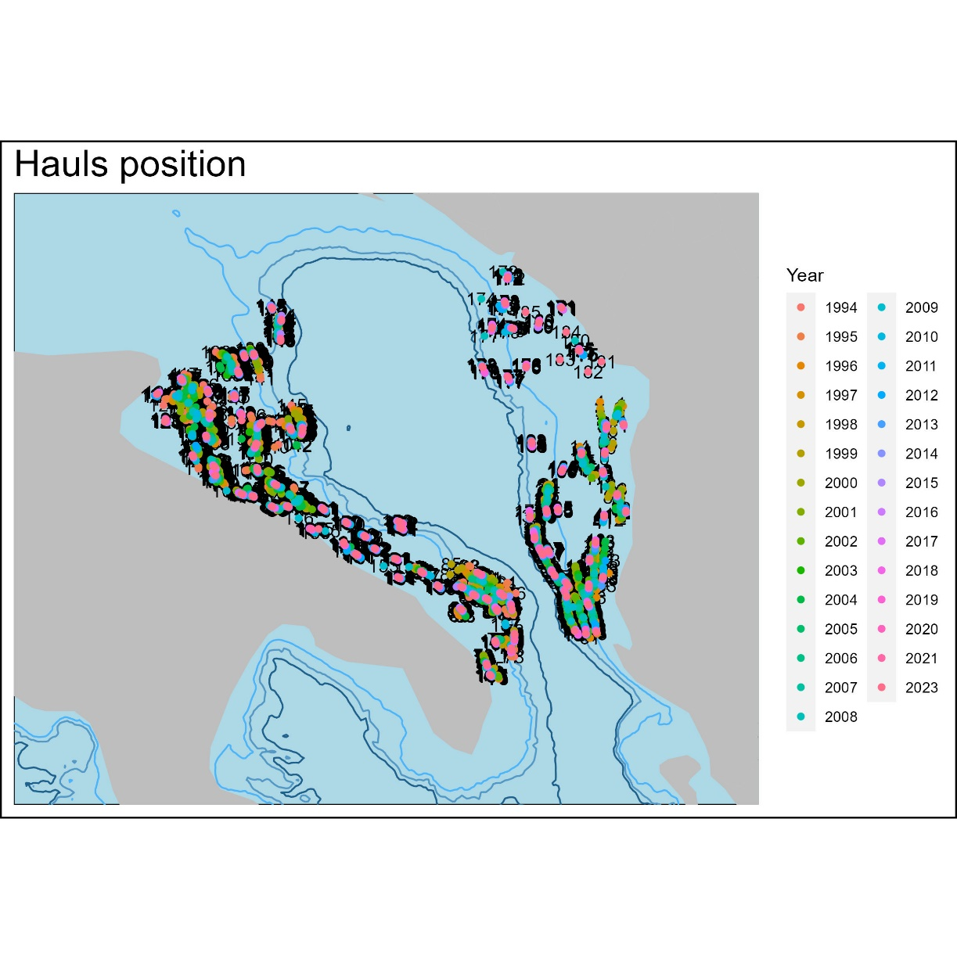
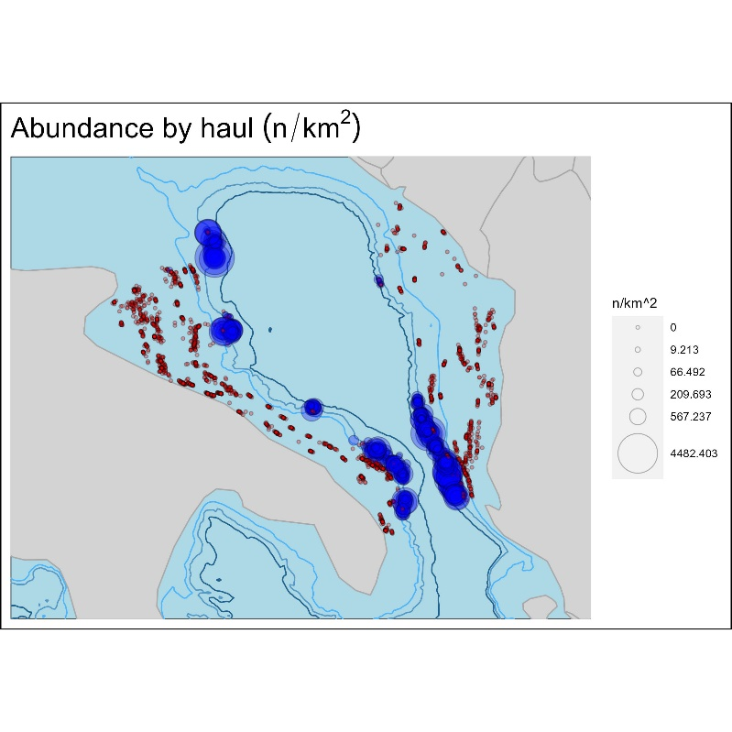
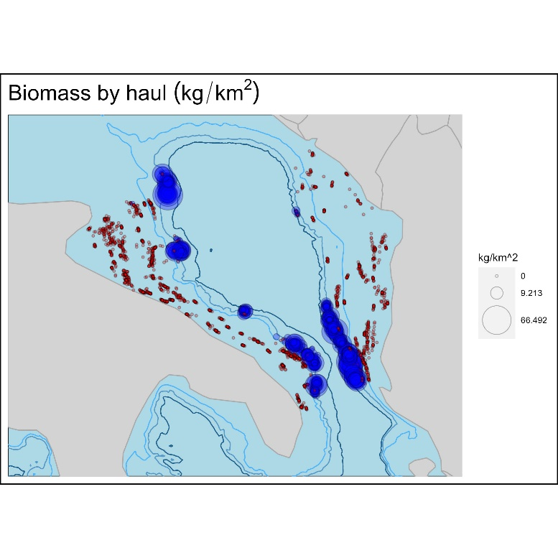
Species depth distribution
Hauls spatial distribution
Abundance and biomass bubble plots

Slide 10
Positive hauls %
Abundance index
Abundance 1/CV
Abundance index of males and females
Abundance index by stratum
males
females

Slide 11
Biomass
Biomass by stratum
Sex ratio
Mean Individual Weight
Mean Individual Weight by stratum

Slide 12
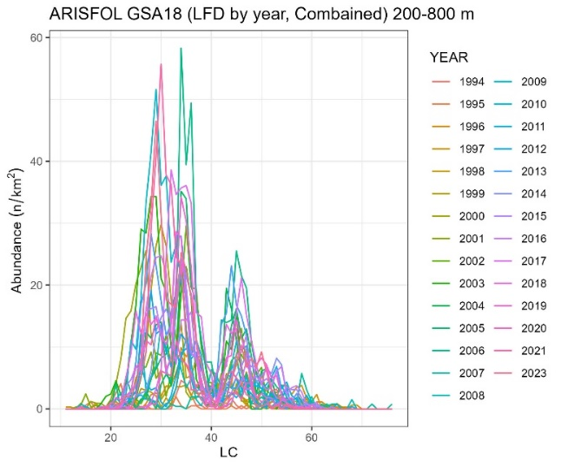
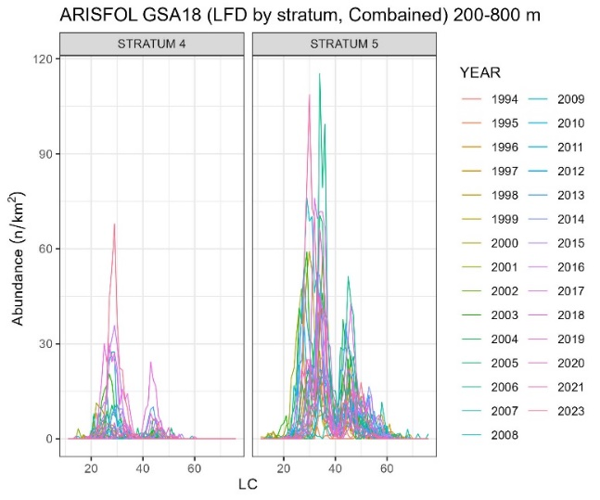
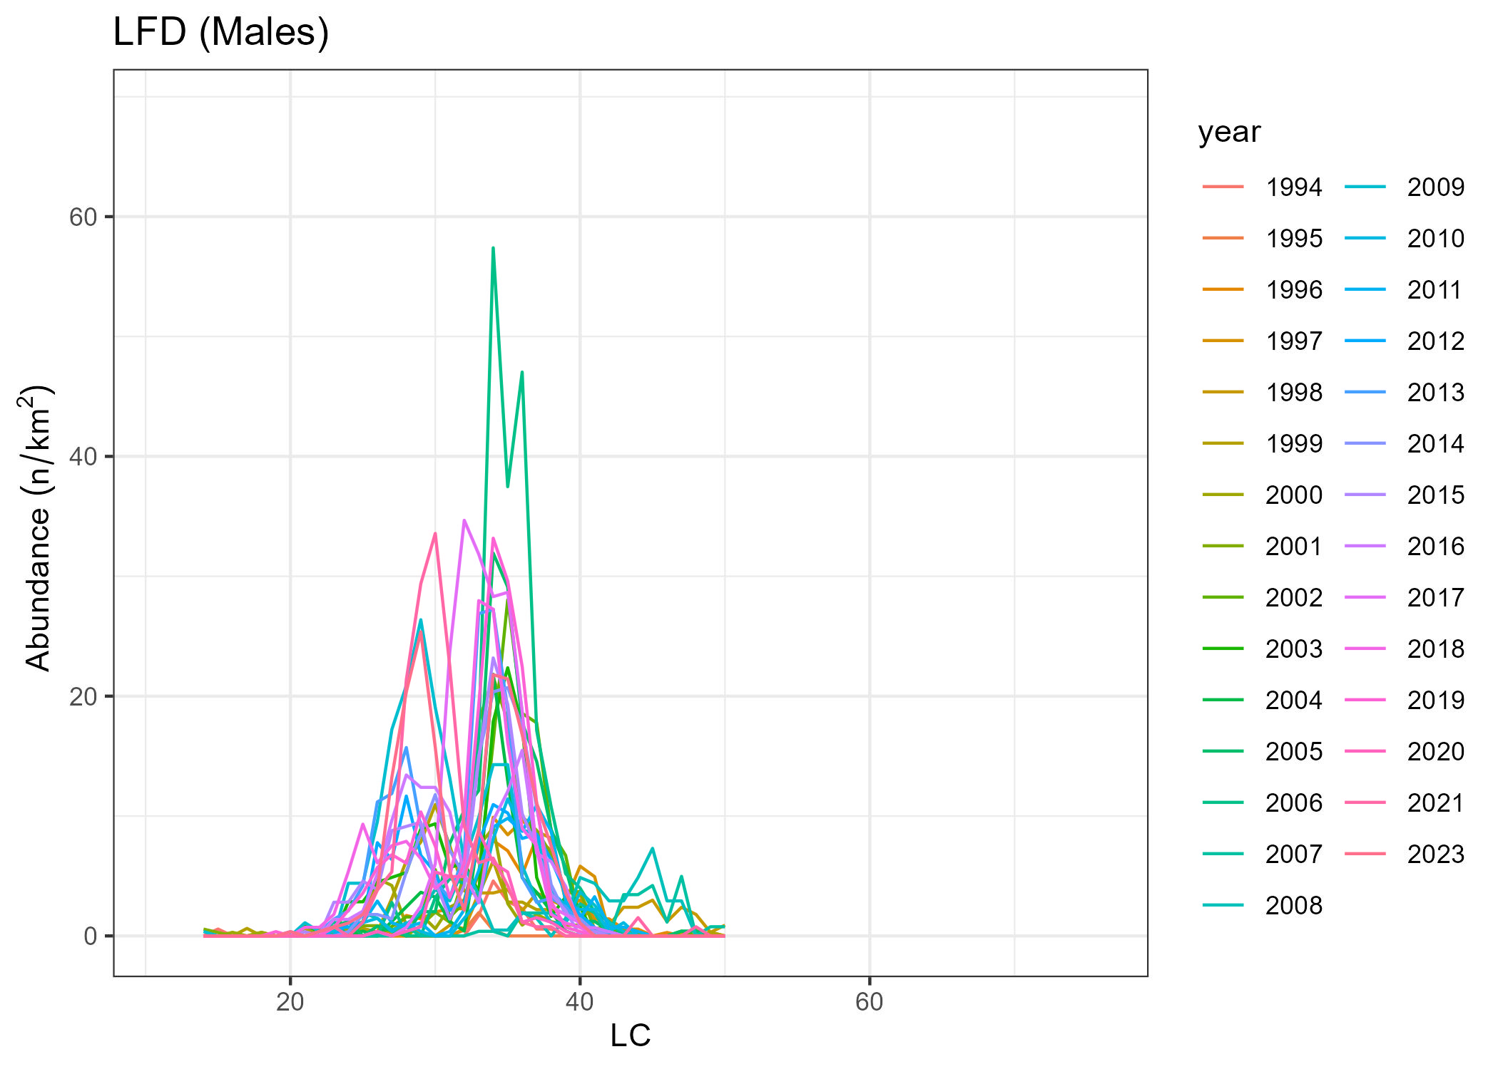
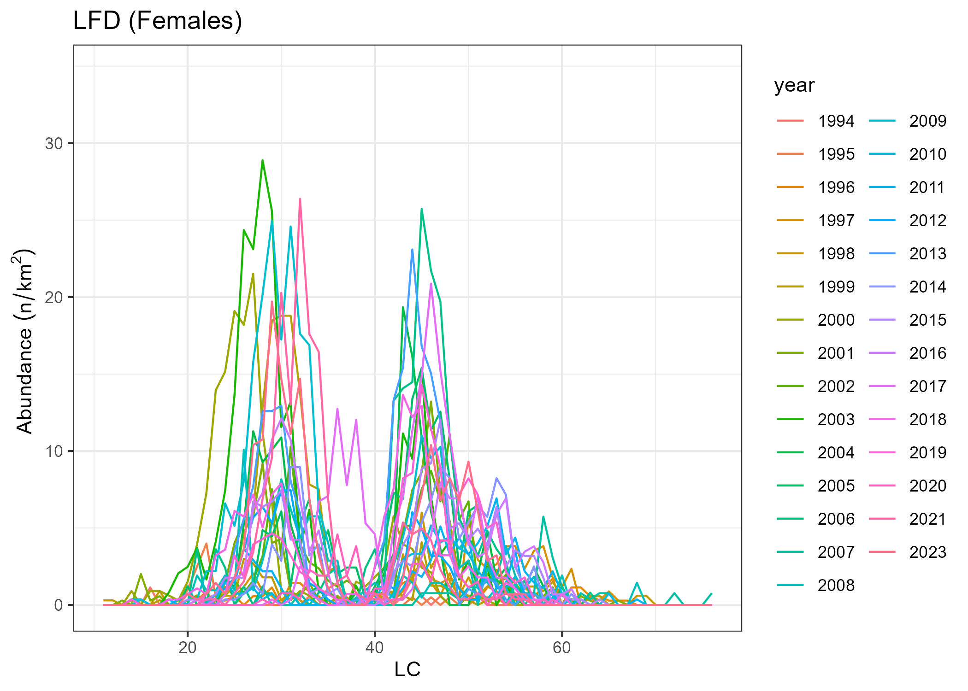
LFD
LFD by stratum
LFD by sex
males
females
L50
L95

Slide 13
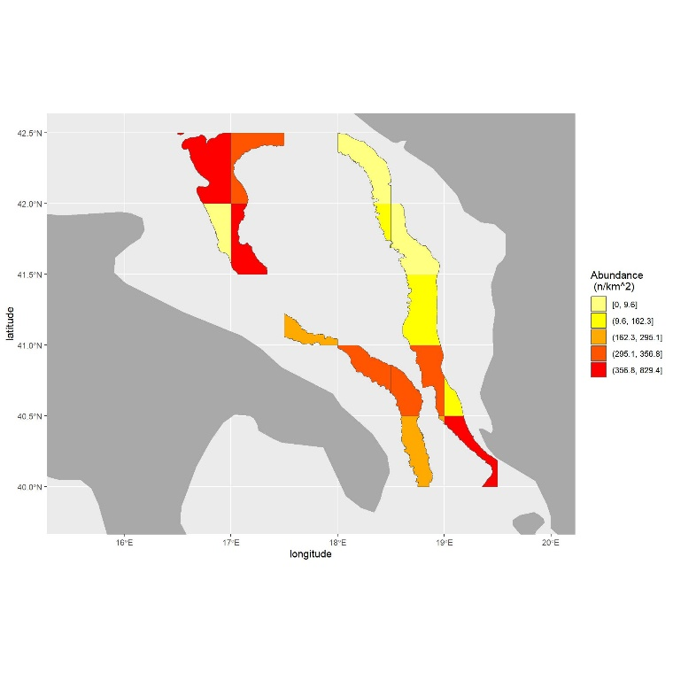
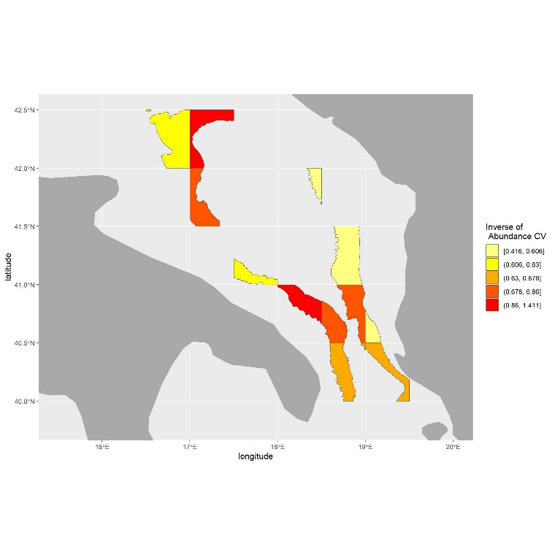
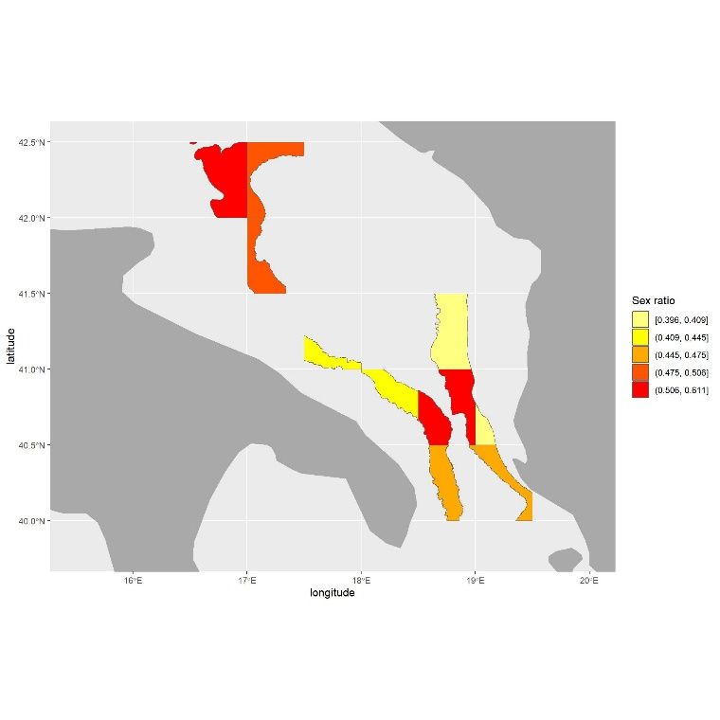
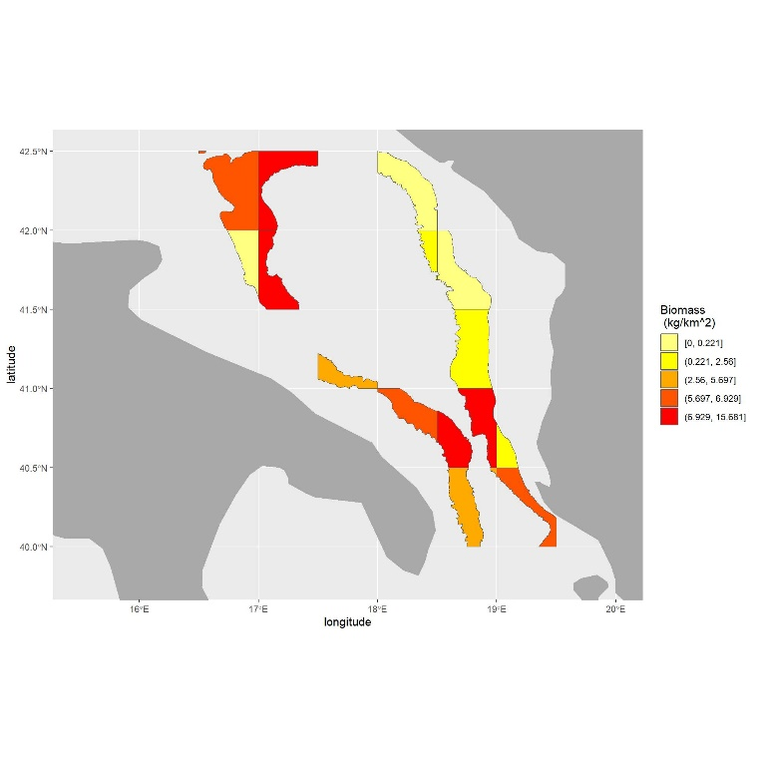
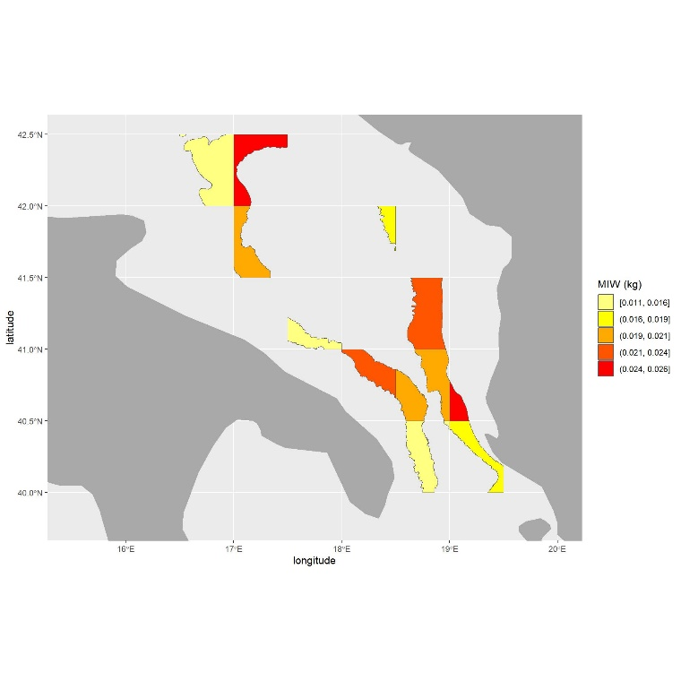
Abundance
Abundance 1/CV
Sex ratio
Biomass
Mean Individual Weight

Slide 14
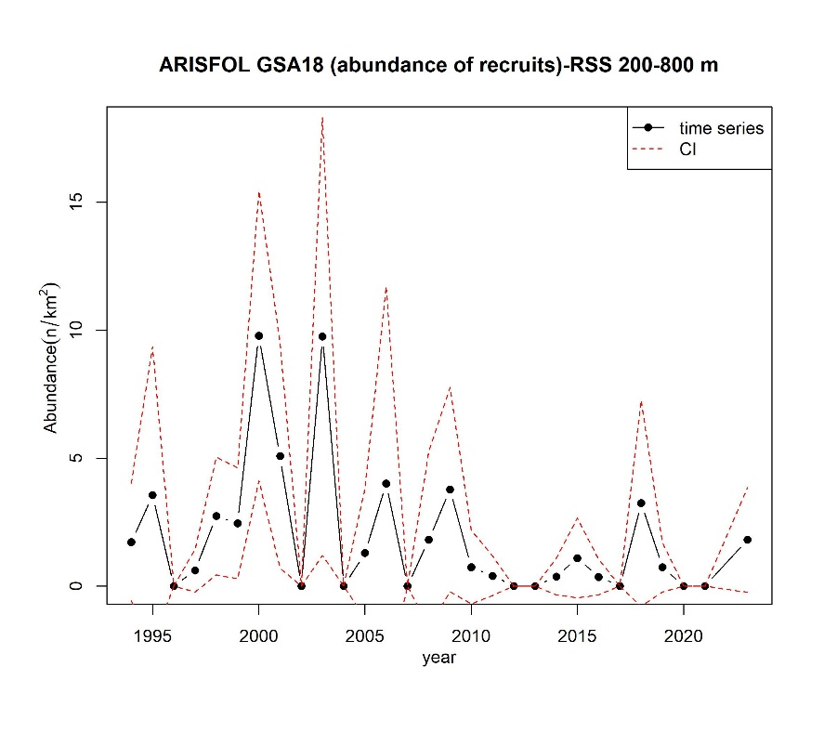
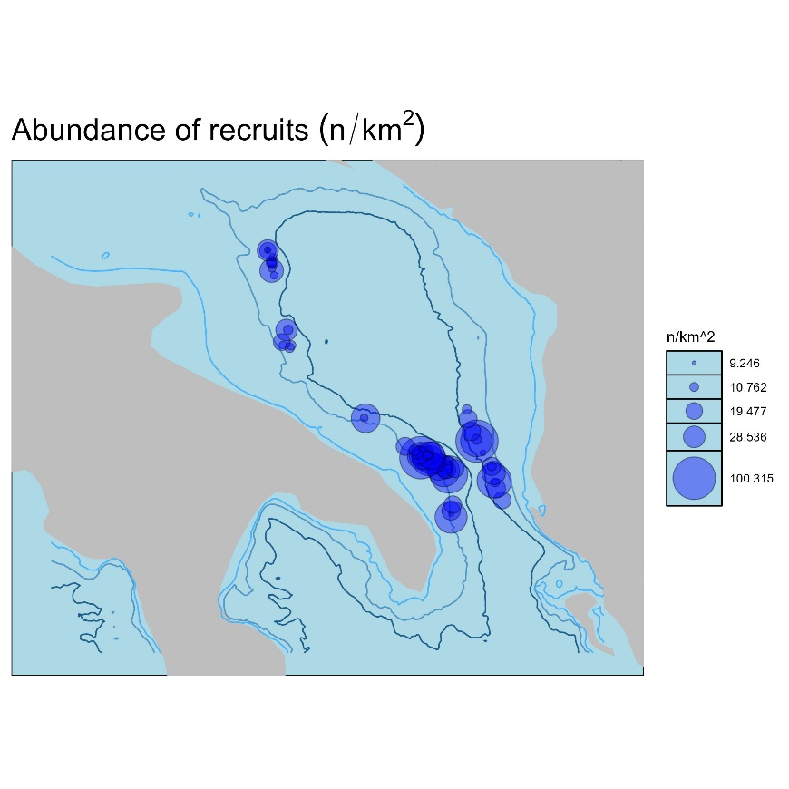
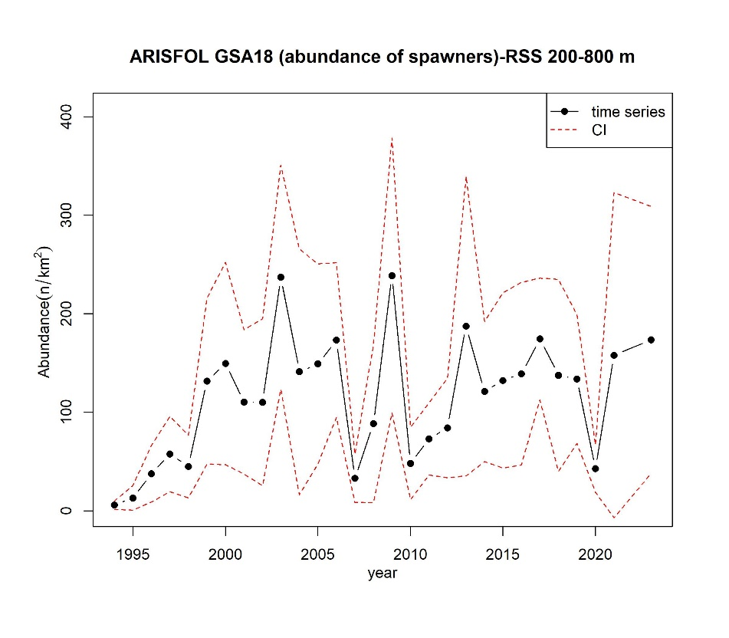
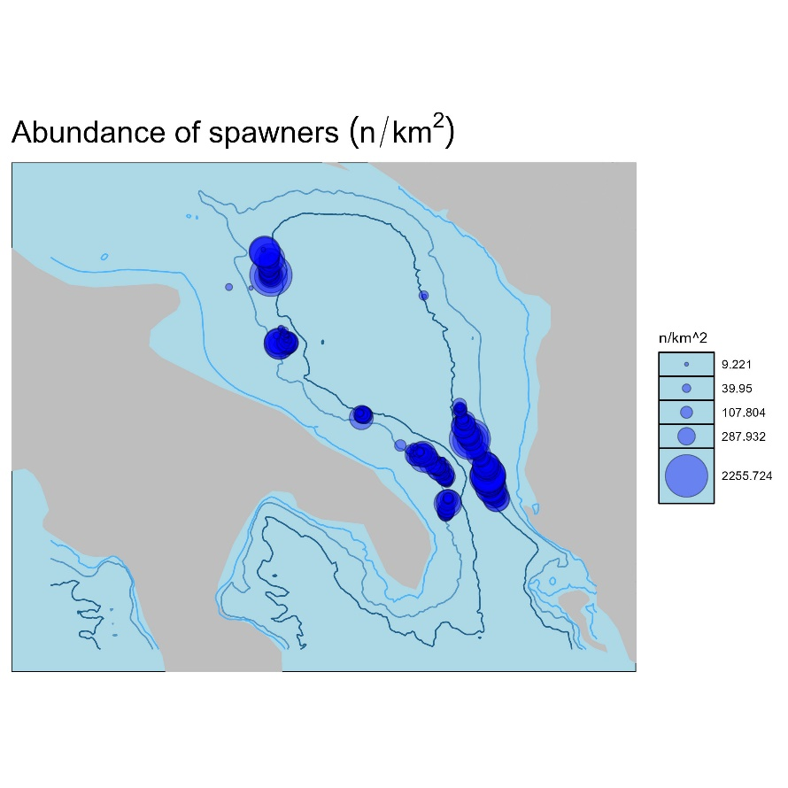
Abundance of recruits
Abundance of spawners

Slide 15
Final remarks
BioIndex is specifically designed for fisheries survey data analysis and integrates with the RDBFIS environment, ensuring streamlined workflows and consistent data processing.
It enables the estimation of critical biological indicators, including abundance, biomass, sex ratio, and mean individual weight, across various aggregation levels (GSA, country, strata). Additionally, it offers robust spatial and trend analysis capabilities, standardizing survey data analyses at the regional level.
Integrated within RDBFIS, BioIndex operates with validated MEDITS datasets (TA, TB, and TC tables) and ensures high data integrity through RoME checks prior to analysis.
The outputs generated by BioIndex provide valuable information to support stock assessments and fisheries management decisions.

